Slide 1
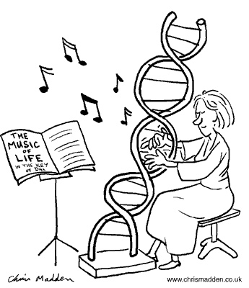
BB2950 Day 3: Friday 10-27-16
Learning objectives:
Explain the difference between bases, nucleosides, and nucleotides.
List the bases found in DNA and RNA.
Describe the secondary structures typical of DNA and RNA.
Describe the two major chemical differences between DNA and RNA, and the effect these differences have on structure and function.
Describe the bonds, forces, and effects that hold together DNA double helices.

Slide 2
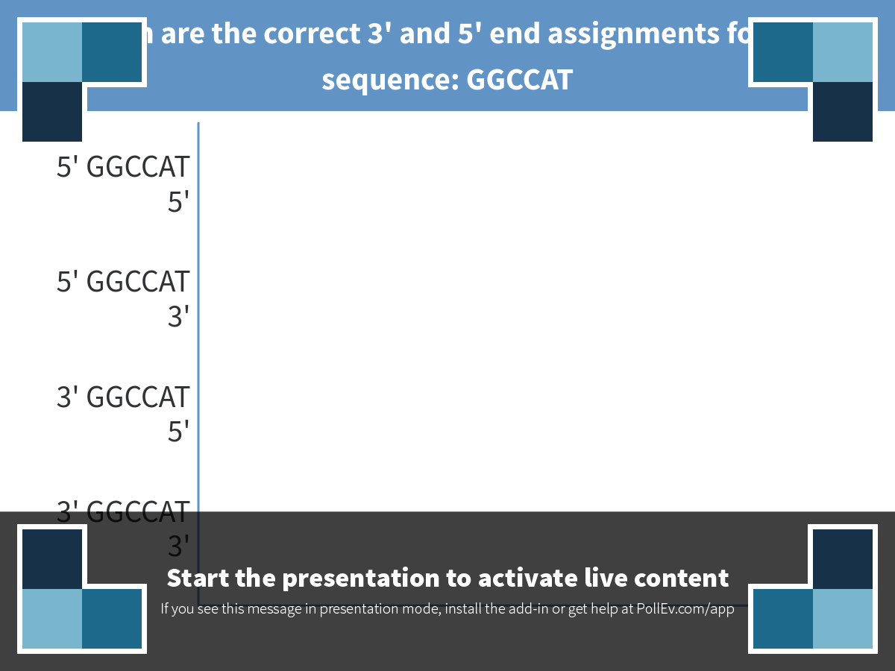
Notes:
Which are the correct 3' and 5' end assignments for this sequence: GGCCAT
https://www.polleverywhere.com/multiple_choice_polls/pBwv4FtSpK9tCZE

Slide 3
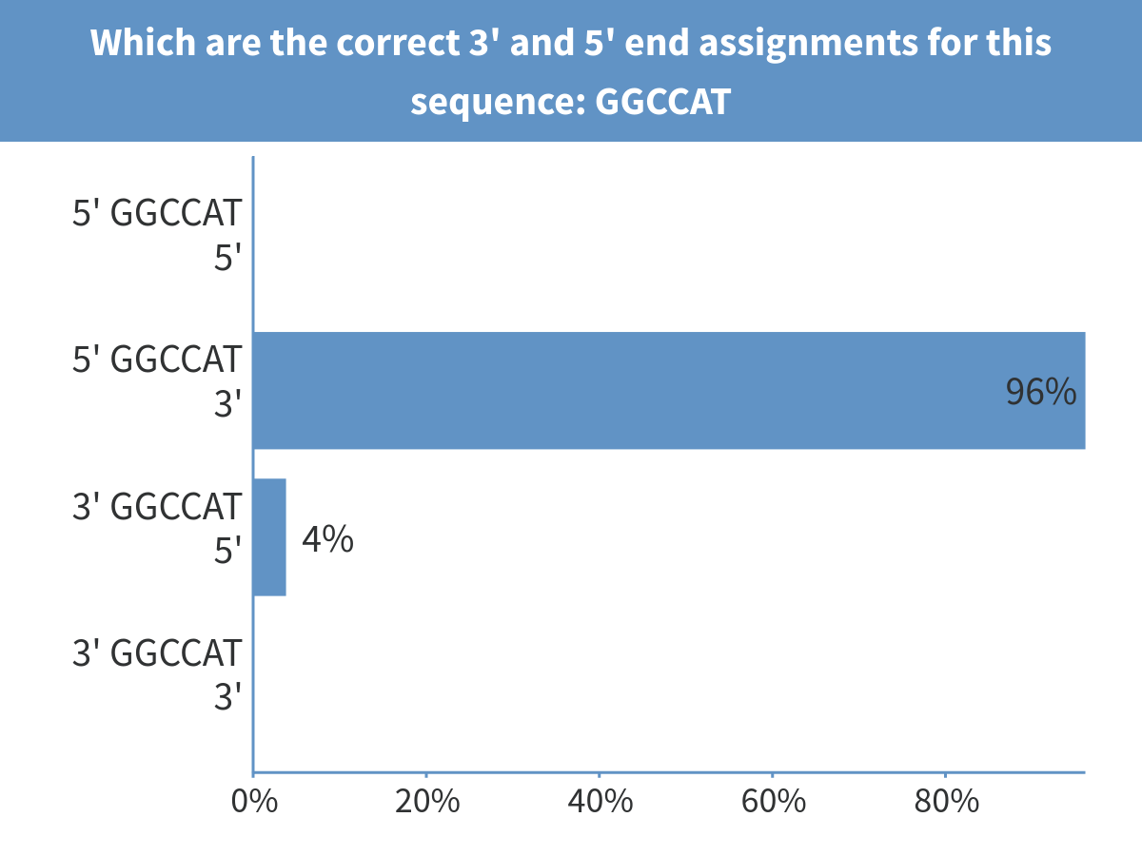
Notes:
Which are the correct 3' and 5' end assignments for this sequence: GGCCAT

Slide 4
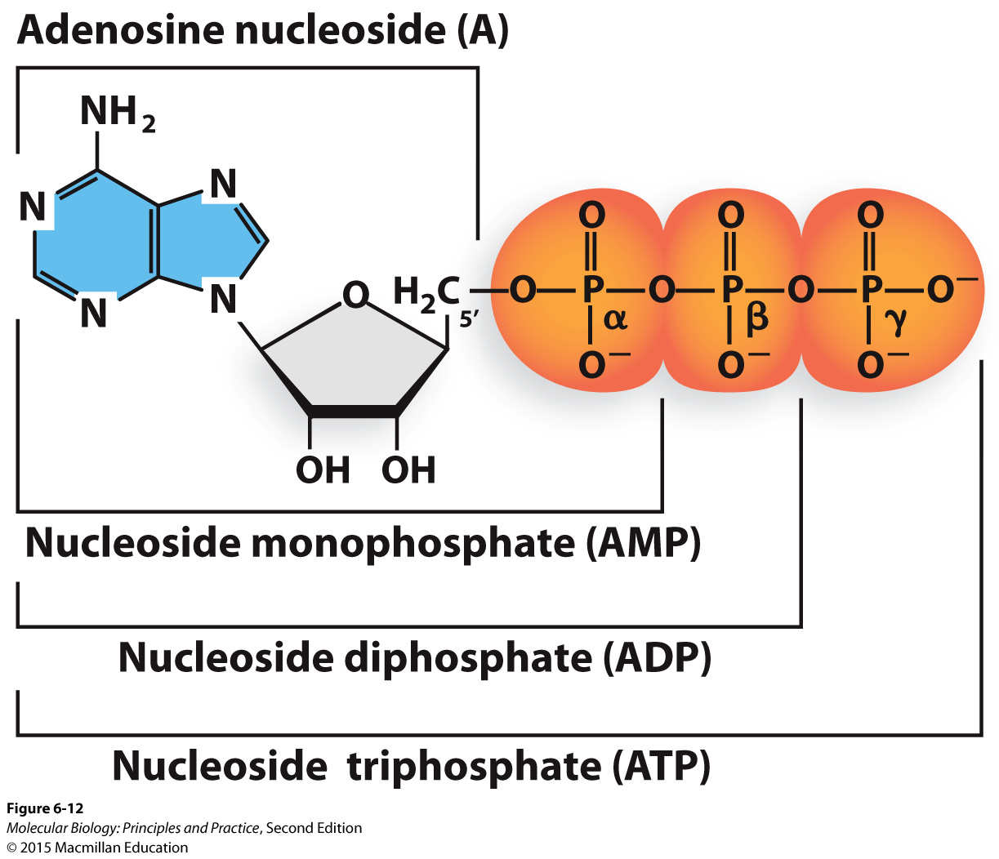
Nucleic acids are made of (deoxy)ribonucleotides

Slide 5
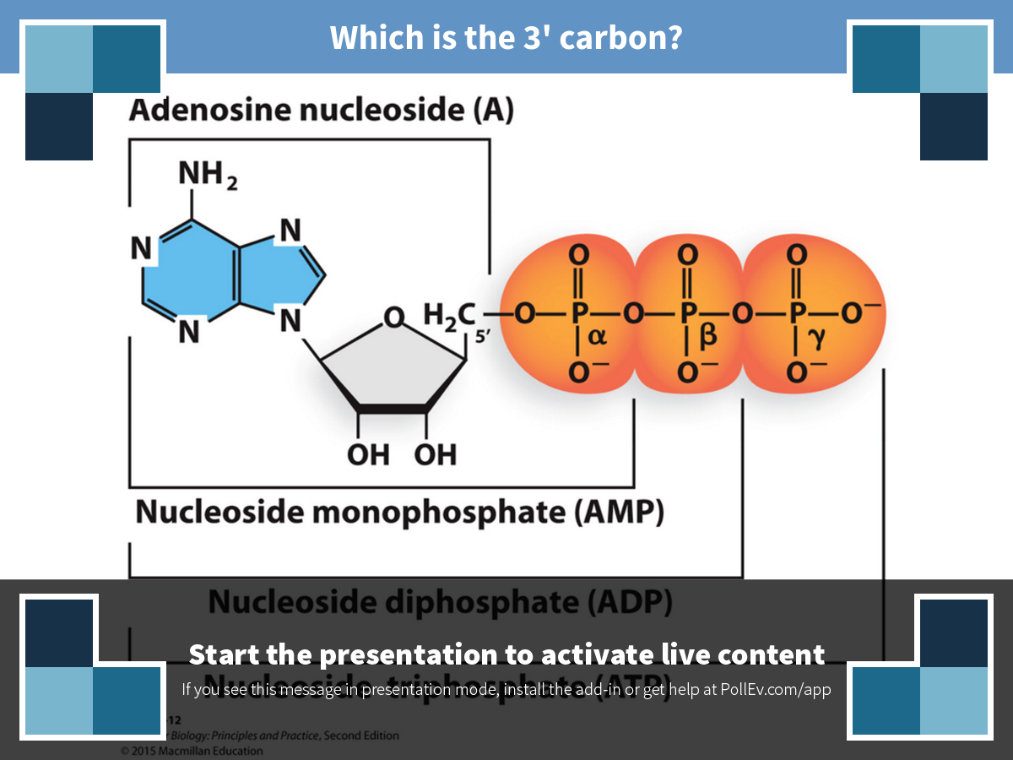
Notes:
Which is the 3' carbon?
https://www.polleverywhere.com/clickable_images/ppghl09CzYZwK4J

Slide 6
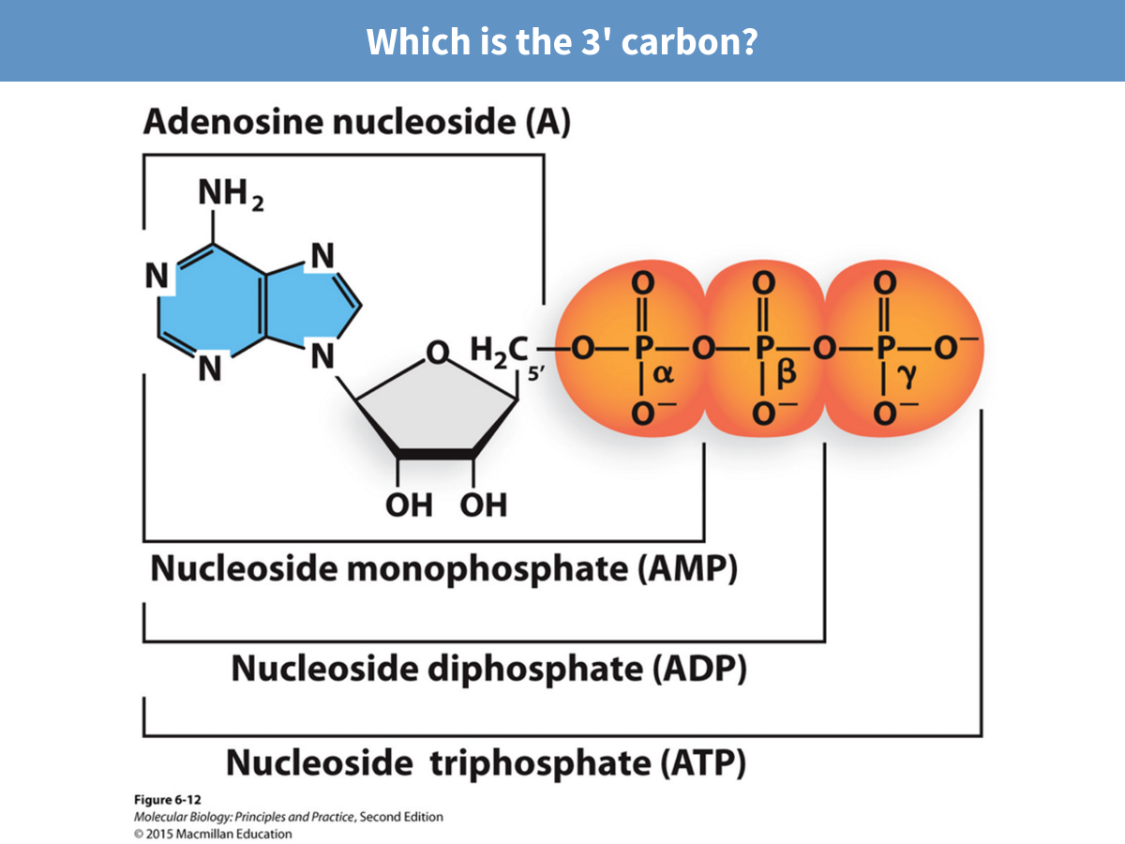
Notes:
Which is the 3' carbon?

Slide 7
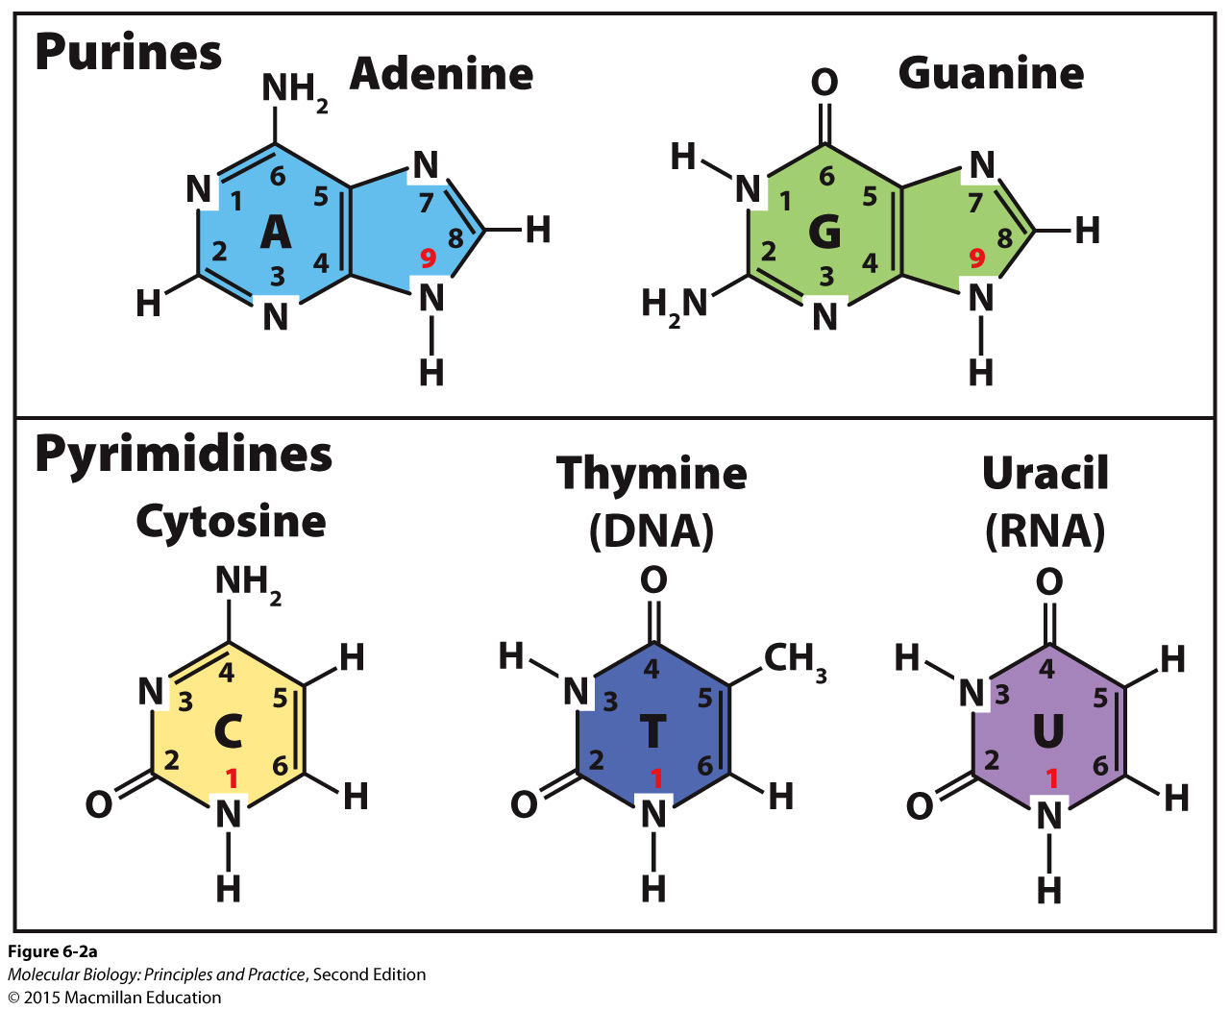
The five major nucleobases

Slide 8
Nomenclature
Base | Nucleoside | Nucleotide
Adenine | (deoxy)Adenosine | Adenosine monophosphate (AMP), Adenosine triphosphate (ATP), deoxyadenosine triphosphate (dATP), etc.
Guanine | (deoxy)Guanosine
Cytosine | (deoxy)Cytidine
Thymine | (deoxy)Thymidine
Uracil | (deoxy)Uridine

Slide 9
Nomenclature
Base | Nucleoside | Nucleotide
Adenine | (deoxy)Adenosine | Adenosine monophosphate (AMP), Adenosine triphosphate (ATP), deoxyadenosine triphosphate (dATP), etc.
Guanine | (deoxy)Guanosine
Cytosine | (deoxy)Cytidine
Thymine | (deoxy)Thymidine
Uracil | (deoxy)Uridine
Learn the names of the bases
Learning the nucleoside names is optional
Be prepared to tell me the composition of a given nucleotide (example: dGTP is a nucleotide composed of a guanine base, deoxyribose, and a 5’ triphosphate).

Slide 10
Nomenclature for nucleic acid structure
Notes:
Primary structure: order of nucleotides
Secondary structure: base-pairing
(Tertiary structure: 3-dimensional structure)

Slide 11
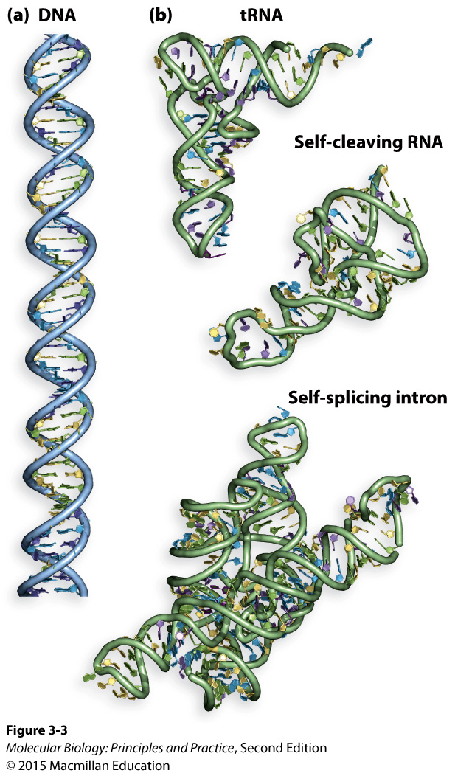
Cellular DNA is usually present in double helices, while RNA takes on more diverse structures.
DNA plays a mainly informational role, while RNA plays informational, structural, and catalytic roles.

Slide 12
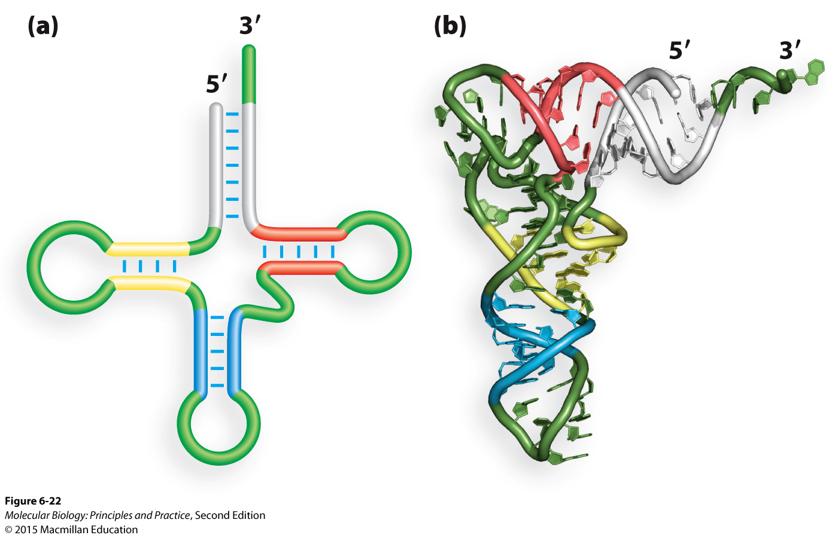
A tRNA in 2D and 3D
RNA structures often involve intramolecular basepairing

Slide 13
Why does RNA behave so differently from DNA?

Slide 14
Why does RNA behave so differently from DNA?

Slide 15
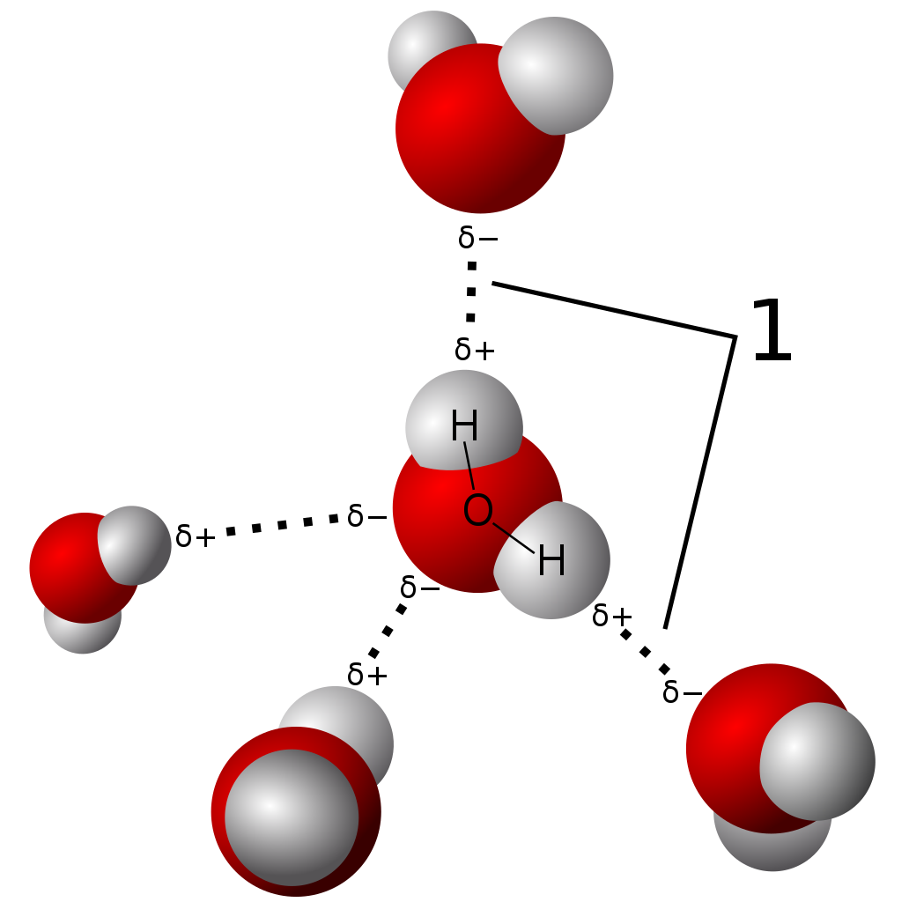
Hydrogen bonds: attraction between hydrogens with partial positive charges and other atoms with partial negative charges.
Hydrogen bonds
Graphic credit: Wikimedia commons/User Qwerter at Czech wikipedia

Slide 16
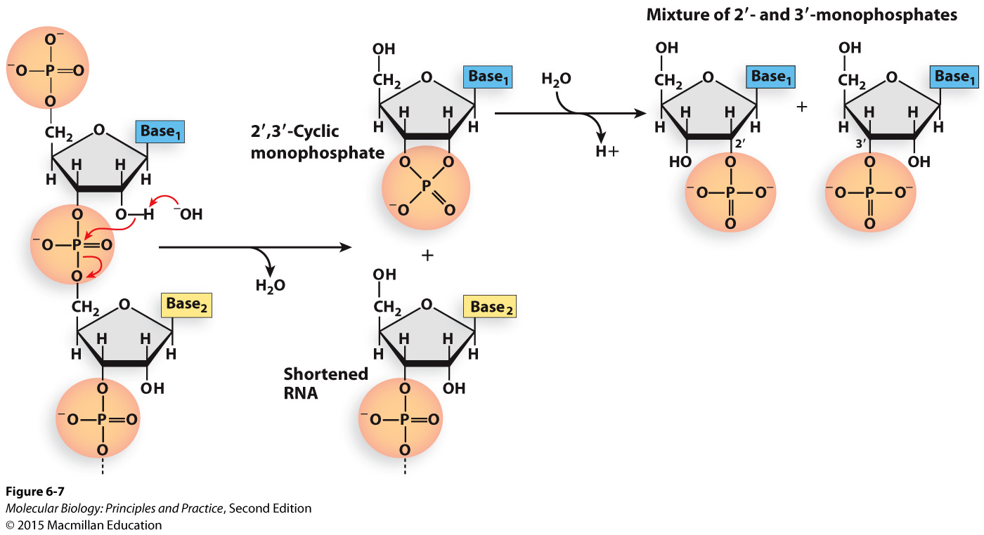
2’ hydroxyls make RNA sensitive to hydrolysis, especially in basic conditions.
Hydrolysis = breaking phosphodiester bond
Be careful: base/basic mean two different things in this context

Slide 17
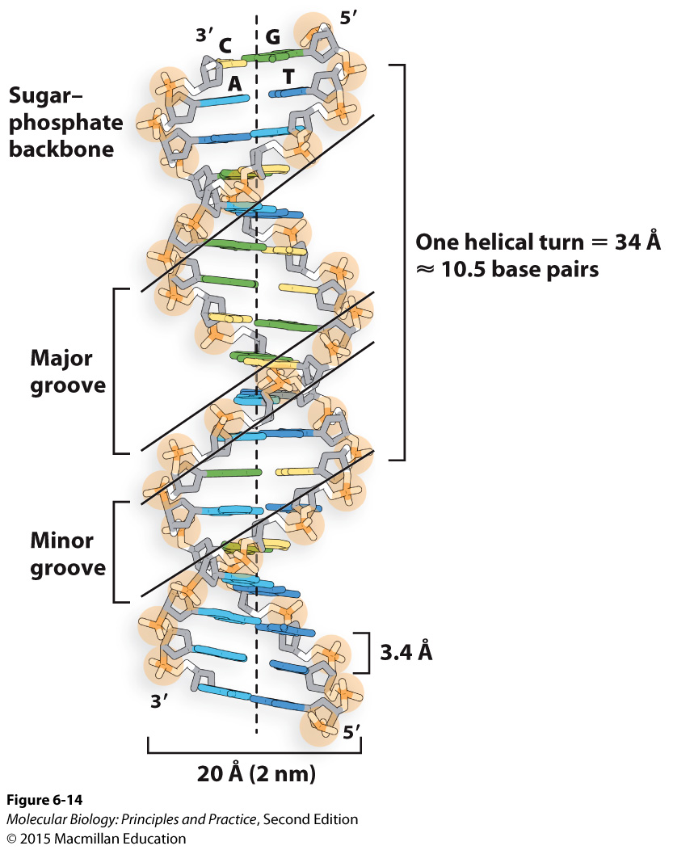
What causes DNA to form double helices?

Slide 18
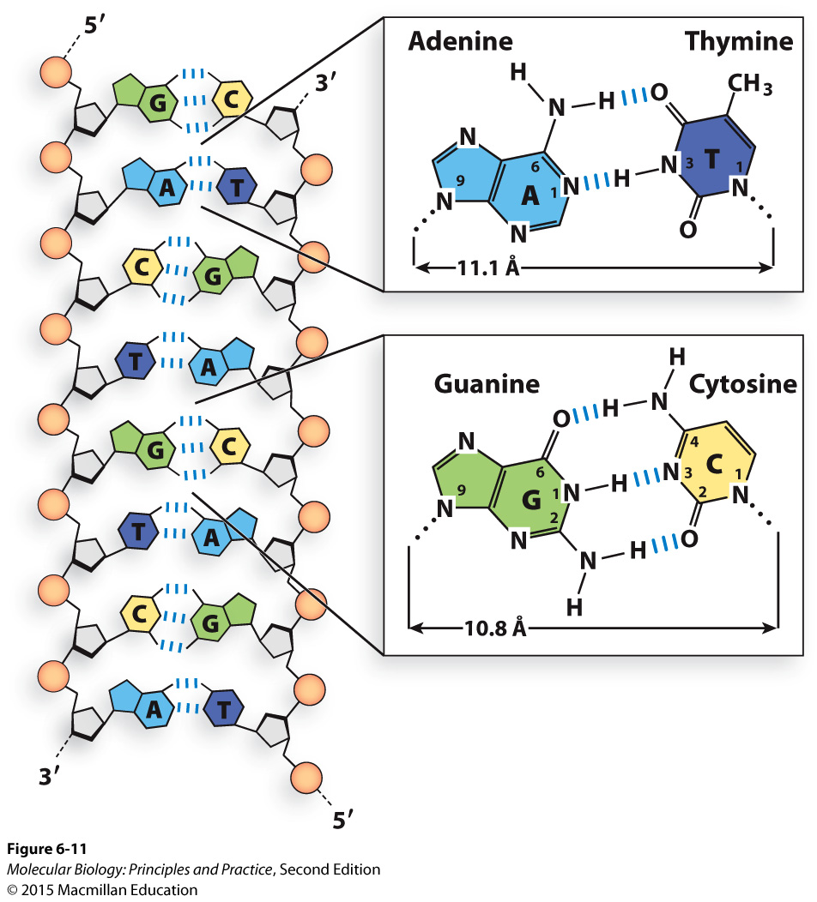
Hydrogen bonds are responsible for base-pairing
Notes:
Note that uracil is identical to thymine except for the methyl group, so base-pairing is unaffected.

Slide 19
Hydrogen bonds are responsible for base-pairing
Purines base-pair with pyrimidines to maintain equal spacing between the backbones
A-T bonds are weaker than G-C bonds
Notes:
Note that uracil is identical to thymine except for the methyl group, so base-pairing is unaffected.

Slide 20
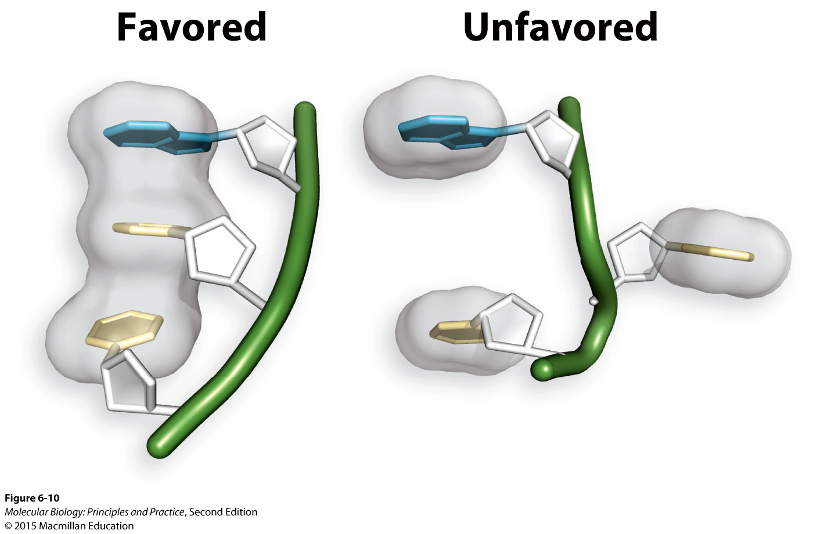
Base stacking: conjugated ring systems are flat and hydrophobic, favoring stacking interactions
Hydrophobic effects, van der Waals interactions, and electrostatic interactions all contribute to base stacking
Stacking is NOT base-specific, although some stacks are more energetically favorable than others.

Slide 21
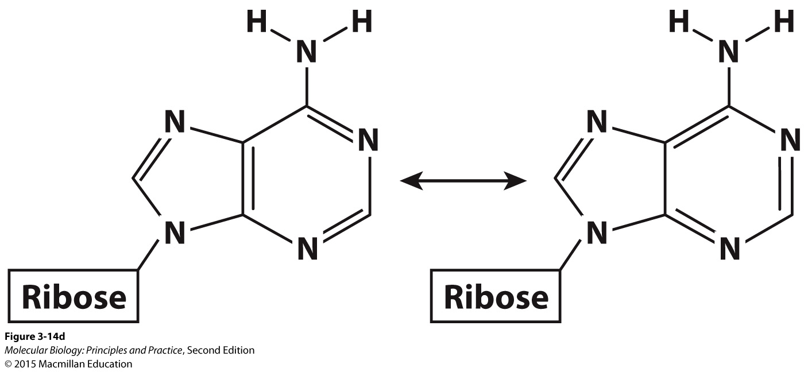
Conjugated ring systems have decentralized electrons (resonance)

Slide 22
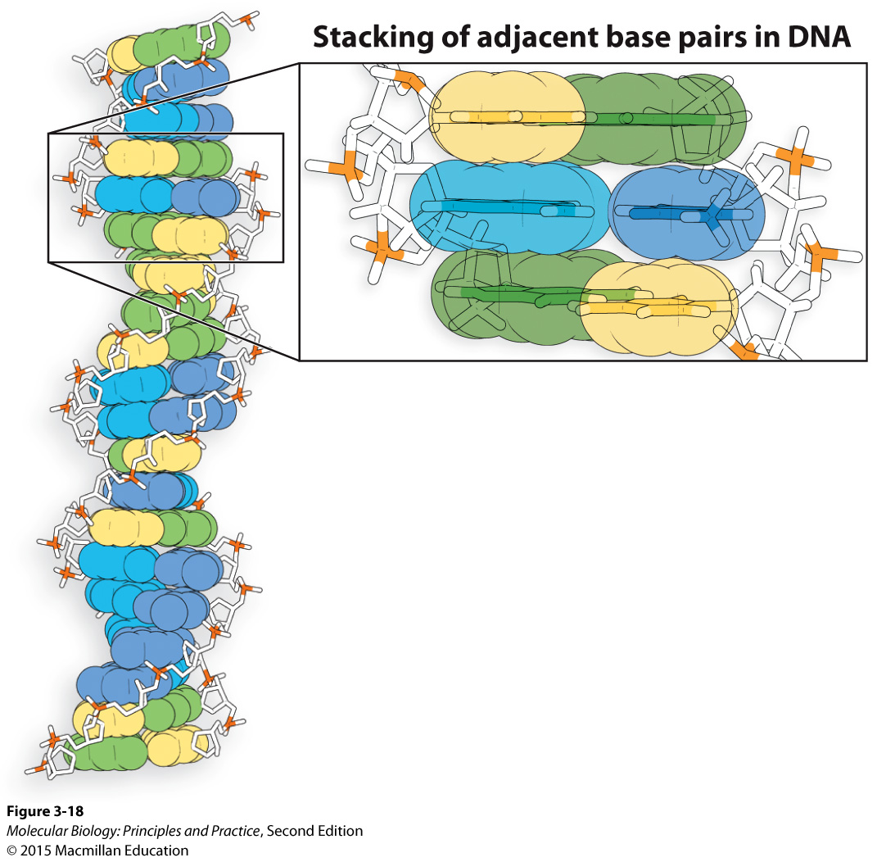
Circles indicate van der Waals radii (roughly, outer boundaries of electron clouds)

Slide 23
The combination of base-pairing and base stacking (many weak interactions) hold double helices together.
The shape is also influenced by repulsion between negatively charged phosphates.
The helix is asymmetric: major and minor grooves.
Strands are antiparallel.
Notes:
Each of these bonds or interactions is individually weak; their sum is strong.

